Slide 1
System Design: Functional and Non-Functional Requirements of System Design
System Design(SD)(22CS024)
Bachelor of Engineering- Computer Science & Engineering
Department of Computer Science & Engineering
Chitkara University Institute of Engineering and Technology, Chitkara University, Punjab, India

Slide 2
Requirements
Requirements analysis is an essential process that enables the success of a system or software project to be assessed.
Requirements are generally split into two types:
Functional
Non-functional requirements.

Slide 3
Types of requirements
functional requirements: define the specific behavior or functions of a system.
non-functional requirements: specify how the system performs its tasks, focusing on attributes like performance, security, scalability, and usability.

Slide 4
How to Gather Functional and Non-functional Requirements
Gathering requirements involves multiple approaches and collaboration between the development team, stakeholders, and end-users:
1. Functional Requirements:
Interviews: Talk to stakeholders or users to understand their needs.
Surveys: Distribute questionnaires to gather input from a larger audience.
Workshops: Host sessions to brainstorm features and gather feedback.
2. Non-functional Requirements:
Performance Benchmarks: Consult with IT teams to set expectations for performance and load.
Security Standards: Consult with security experts to define the best practices for data protection.
Usability Testing: Test the system to find areas where users might struggle and refine the interface.

Slide 5
What are Functional Requirements?
These are the requirements that the end user specifically demands as basic facilities that the system should offer.
All these functionalities need to be necessarily incorporated into the system as a part of the contract.
These are represented or stated in the form of input to be given to the system, the operation performed and the output expected.
They are the requirements stated by the user which one can see directly in the final product, unlike the non-functional requirements.
Examples:
What are the features that we need to design for this system?
What are the edge cases we need to consider, if any, in our design?

Slide 6
What are Non-Functional Requirements?
These are the quality constraints that the system must satisfy according to the project contract.
The priority or extent to which these factors are implemented varies from one project to another.
They are also called non-behavioral requirements. They deal with issues like:
Portability
Security
Maintainability
Reliability
Scalability
Performance
Reusability
Flexibility

Slide 7
Examples:
Each request should be processed with the minimum latency?
System should be highly available.

Slide 8
Examples of Functional and Non-functional Requirements
1. Online Banking System
1. Functional Requirements:
Users should be able to log in with their username and password.
Users should be able to check their account balance.
Users should receive notifications after making a transaction.
2. Non-functional Requirements:
The system should respond to user actions in less than 2 seconds.
All transactions must be encrypted and comply with industry security standards.
The system should be able to handle 100 million users with minimal downtime.

Slide 9
2. Food Delivery App
1. Functional Requirements
Users can browse the menu and place an order.
Users can make payments and track their orders in real time.
2. Non-functional Requirements:
The app should load the restaurant menu in under 1 second.
The system should support up to 50,000 concurrent orders during peak hours.
The app should be easy to use for first-time users, with an intuitive interface.

Slide 10
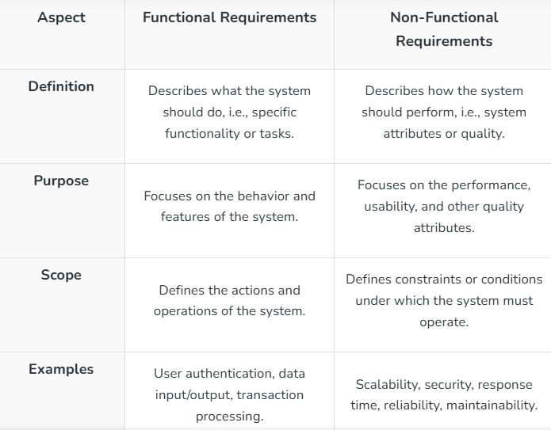
Differences between Functional Requirements and Non-Functional Requirements:

Slide 11
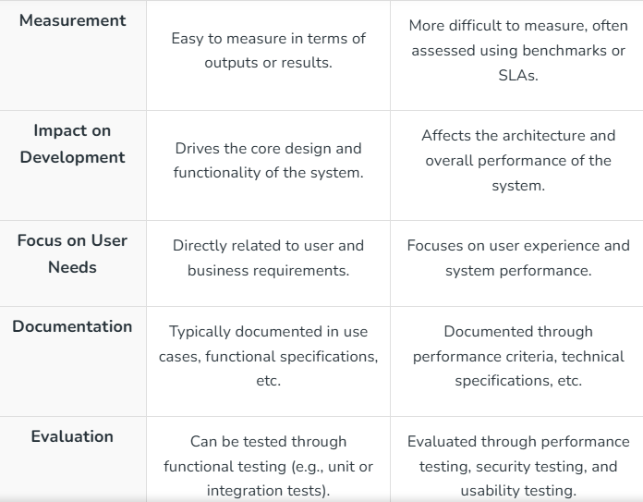

Slide 12
Importance of Balancing Both Functional and Non-Functional Requirements
Improves User Experience
Enhances System Performance
Prevents Bottlenecks and Failures
Reduces Long-Term Costs
Supports System Evolution

Slide 13
Common Challenges in Defining these Requirements
Ambiguity in Requirements
Changing Requirements
Difficulty in Prioritization
Measuring Non-Functional Requirements:
Functional requirements are often straightforward to test, but non-functional requirements like usability, scalability, and reliability are harder to measure and validate.
Overlapping or Conflicting Requirements
Notes:
Requirements are often unclear, making it difficult to interpret what the system should do (functional) and how it should perform (non-functional).
Changing Requirements: As projects evolve, functional and non-functional requirements often change due to shifting business goals, market trends, or user needs.
Difficulty in Prioritization: Deciding which functional and non-functional requirements are most important is often difficult. Functional needs can overshadow non-functional ones, such as security or scalability.
Overlapping or Conflicting Requirements: Sometimes, functional and non-functional requirements can overlap or conflict. adding complex security features (non-functional) might slow down the performance (another non-functional requirement).

Slide 14
Thankyou

